Slide 1
Session 2: Intro to Data Wrangling
Dan Killian and Ted Papalexopoulos
15.S60 COS 2021
12 January 2021

Slide 2
Many Thanks
Most of the material presented today was taken from, or inspired by, R for Data Science by Hadley Wickham and Garrett Grolemund
https://r4ds.had.co.nz/index.html
Also need to give a shout-out to the student instructors who previously taught this session.

Slide 3
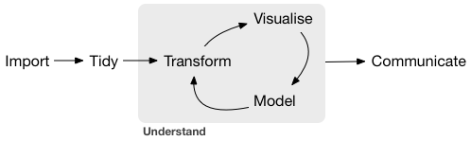
What do we, AS , do?
Data Scientists
Business Intelligence Analysts
Operations Researchers
Data Geeks
The Data Science Workflow
Share the results.
Get the data.
Personal Webpage
Shiny (R)
Structure the data.
Clean the data.
Create charts and figures.
Build models to predict and optimize.
Excel
R
R
R
Python
Julia

Slide 4
Today’s Goals
Introduce R and RStudio
R Basics
Introduce the Tidyverse
Practice Data Wrangling in R
I do not intend…
To make you R power-users in 2 hours.
To convince you that R is the one, true data science tool.
My Hope
That you will leave this session with an appreciation for R’s utility and a clear idea of where to turn if you’d like to learn more.

